Slide 1

WISEPRICE
GADGETS PRICE ANALYSIS AND TRACKING TOOL

Slide 2

PRESENTED BY :
Maanav Chellani
Rashi Chellani
Parth Dabholkar
Anish Dayani
Vedant Devkar
Viraj Dighe

Slide 3
Topics Covered
INTRODUCTION
MONETIZATION STRATEGY
REQUIREMENTS
ADVANTAGES
CONSTRUCTION
LIMITATIONS
WORKING
CONCLUSION

Slide 4

INTRODUCTION
WisePrice uses advanced machine learning to predict electronics prices
Real-time data for easy price comparisons
Historical trends inform future price changes

Slide 5

NEED FOR WISEPRICE
Informed Purchases
Optimizing Business Strategies
Inventory Management
Comparison Shopping
Saves Time and Effort

Slide 6

Requirements
Functional Requirements
Non-functional Requirements
Constraints

Slide 7
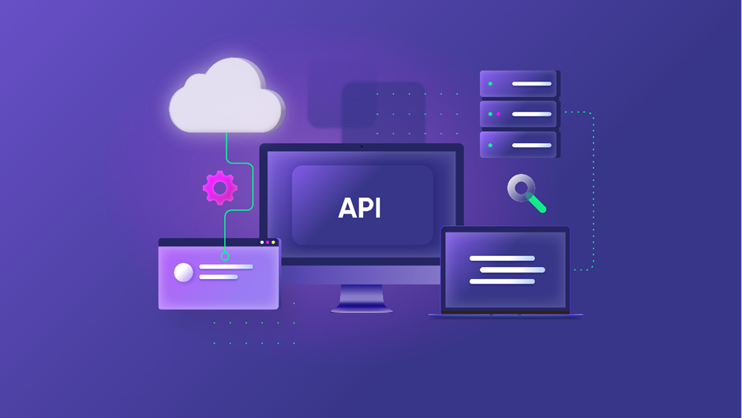
Functional Requirements
Data acquisition and integration
Identify and connect to reliable and diverse data sources
Data Cleansing
Real-time Updates
Machine learning models
Price Prediction
Historical Price Trends

Slide 8

Functional Requirements
User interface
User Registration and Authentication
Product Search
Price Comparison
Product Details

Slide 9
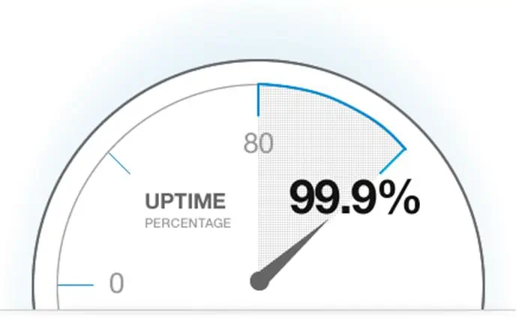

Non Functional Requirements
Performance and Scalability
Response Time
Data Processing
Scalability
Usability
User-Friendly Interface
Accessibility

Slide 10
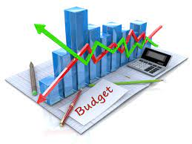
Constraints
Budget
Technological constraints

Slide 11
Construction
Data gathering and cleaning for price analysis
Feature selection and engineering for model input
Building machine learning or AI prediction models
Training and validation of prediction algorithms
Optimization and fine-tuning of model parameters
Deployment and integration into a user-friendly interface
Continuous monitoring and model maintenance

Slide 12
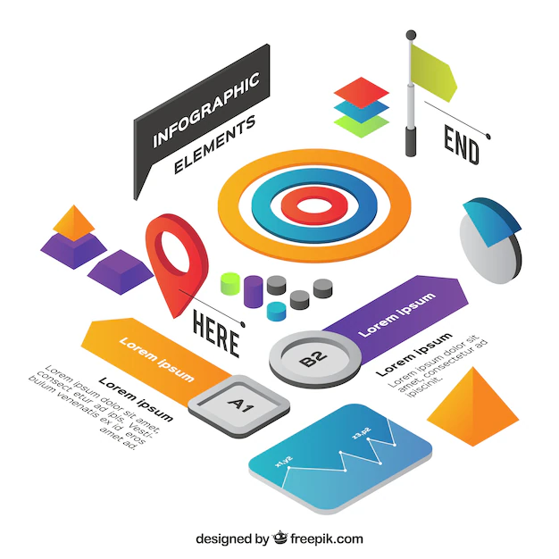
WORKING
Features of WisePrice
Functioning of WisePrice

Slide 13

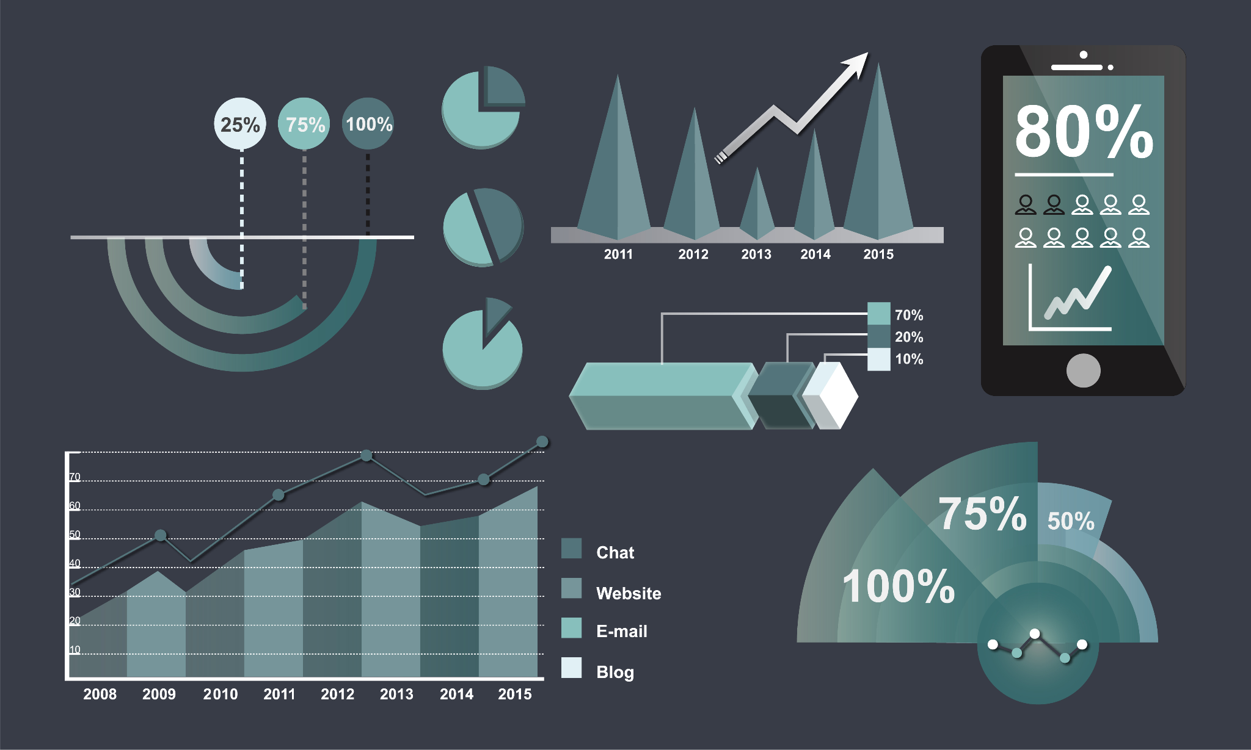
Features of WisePrice
Product Search and Comparison
Price History and Tracking
Price Drop and Alerts
User Reviews and Ratings
Comparison Analytics
Customized Recommendations

Slide 14

Functioning of WisePrice
Data Collection
Data Processing
User Accounts
Price Prediction Algorithm
Integration with Retailer APIs
Review Aggregation
Machine Learning for Recommendations
User Friendly Interface

Slide 15

Advantages
Time Efficiency
Personalized Alerts
User-Friendly Design
Informed-Decision Making

Slide 16

Limitations
Platform Compatibility
Privacy Concerns
Data Accuracy
Monetization Strategies

Slide 17


Monetization Strategies
Data Licensing
Advertising
Affiliate Marketing

Slide 18

Conclusion
Advantage
Saves consumers time and money
Boosts business
Vision -> Smarter future

Slide 19
Thank You

